Slide 1
Object Oriented Programming—C++ Lecture3 Initialization & References
Qijun Zhao
College of Computer Science
Sichuan University
Spring 2023

Slide 2
Course Overview
周次 | 日期 | 理论课主题 | 上机课（4-13周） | 内容
1（校历第2周） | 2月28日 | Introduction
2（校历第3周） | 3月7日 | Types and Structs Initialization and References Streams Containers Iterators and Pointers | To be announced at Week 4 | Features of C++
3（校历第4周） | 3月14日
4（校历第5周） | 3月21日
5（校历第6周） | 3月28日
6（校历第7周） | 4月4日 | Quiz I & Mid-Term Review
7（校历第8周） | 4月11日 | Classes Template Classes Template Functions Functions and Algorithms Operator Overloading Special Member Functions |  | Object Oriented Programming (OOP)
8（校历第9周） | 4月18日
9（校历第10周） | 4月25日
10（校历第11周） | 5月2日
11（校历第12周） | 5月9日
12（校历第13周） | 5月16日 | Quiz II
13（校历第14周） | 5月23日 | Move Semantics |  | Advanced Features of C++
14（校历第15周） | 5月30日 | Type Safety
15（校历第16周） | 6月6日 | Final Review
Acknowledgement: Materials of this course are mainly adapted from CS106L / 106B @ Stanford.

Slide 3
Today
- Initialization
- Using auto
- References
- If time: Const

Slide 4
Definition
Initialization: How we provide initial values to variables

Slide 5
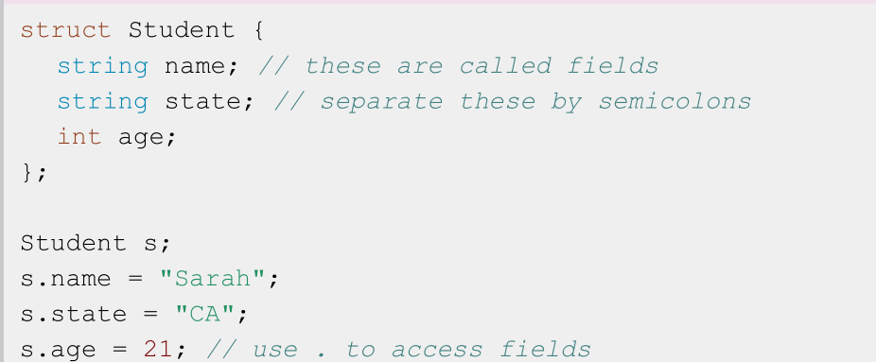
Reminder: Structs in Code

Slide 6
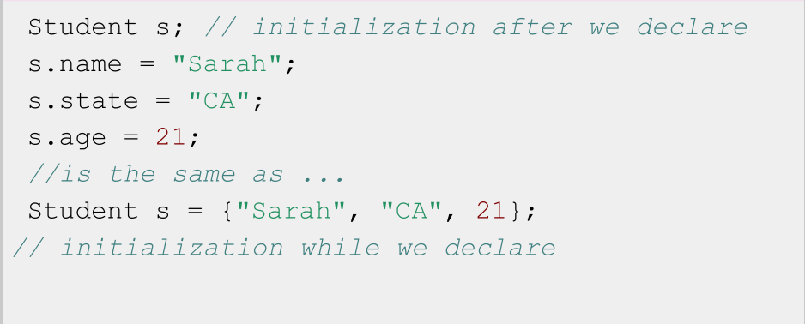
Recall: Two ways to initialize a struct

Slide 7
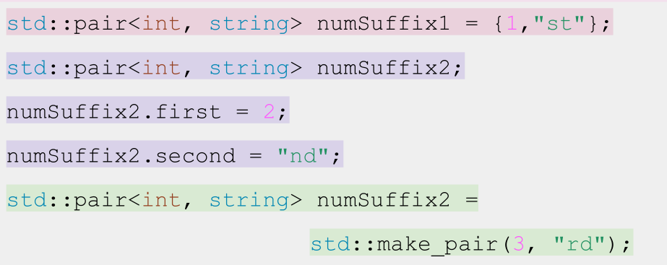
Multiple ways to initialize a pair...

Slide 8
Definition
Uniform initialization: curly bracket {...} initialization. Available for all types, immediate initialization on declaration!

Slide 9
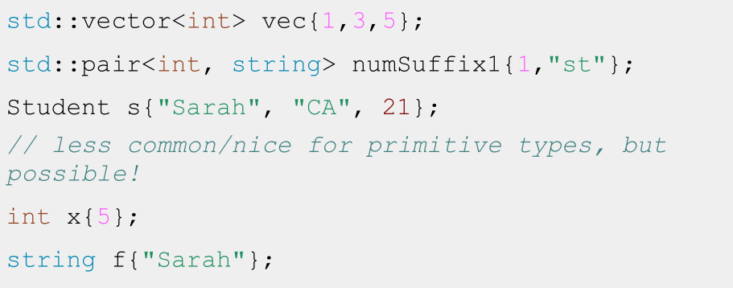
Uniform Initialization

Slide 10
Uniform Initialization

Slide 11
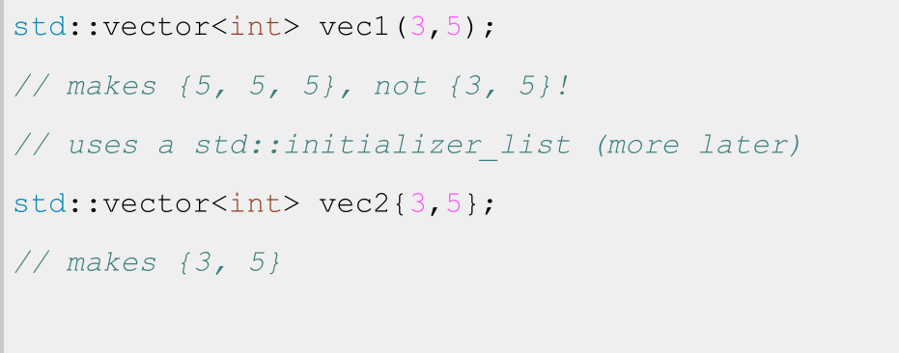
Careful with Vector initialization!

Slide 12
Careful with Vector initialization!

Slide 13
TLDR: use uniform initialization to initialize every field of your non-primitive typed variables - but be careful not to use vec(n, k)!

Slide 14
Today
- Initialization
- Using auto
- References
- If time: Const

Slide 15
Definition
Recap: Type Deduction with auto
auto: Keyword used in lieu of type when declaring a variable, tells the compiler to deduce the type.

Slide 16
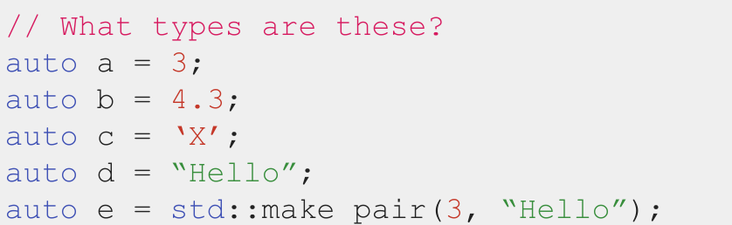
Type Deduction using auto
📝 auto does not mean that the variable doesn’t have a type.
It means that the type is deduced by the compiler.

Slide 17
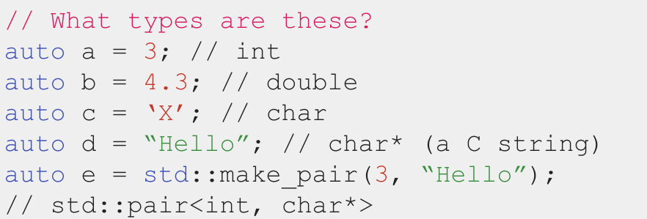
Type Deduction using auto
📝 auto does not mean that the variable doesn’t have a type.
It means that the type is deduced by the compiler.

Slide 18

auto does not mean that the variable doesn’t have a type.
It means that the type is deduced by the compiler.

Slide 19
Code Demo!
quadratic.cpp

Slide 20
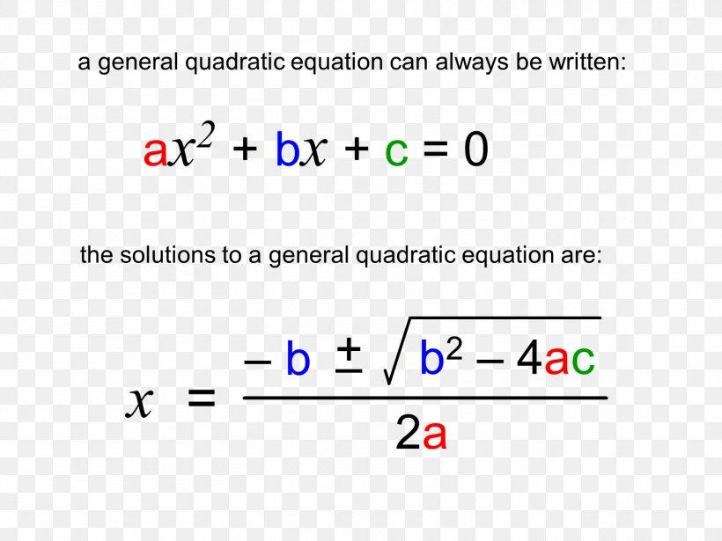
Radical
If Radical < 0, no real roots

Slide 21
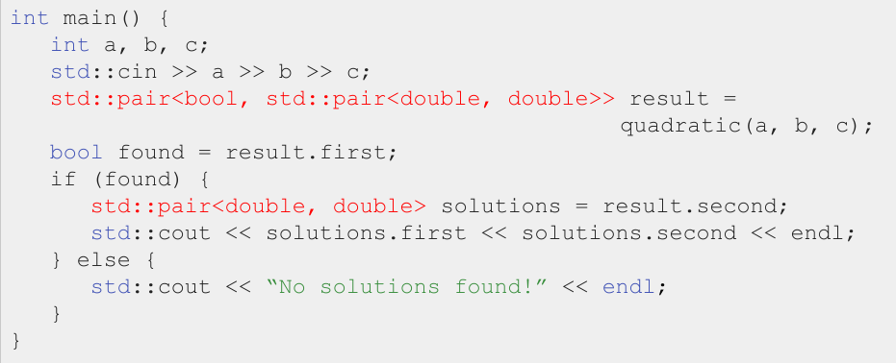
Quadratic: Typing these types out is a pain...

Slide 22
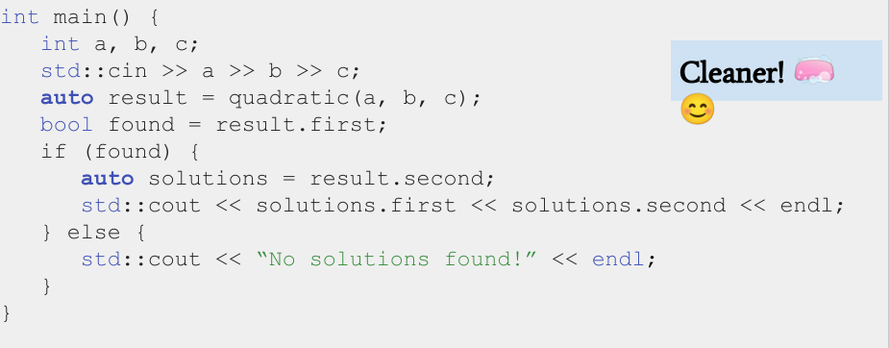
Quadratic: Typing these types out is a pain...

Slide 23
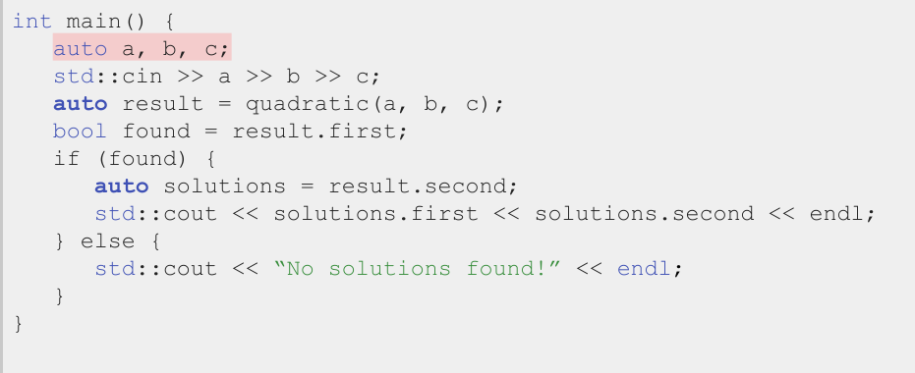
Don’t overuse auto!

Slide 24
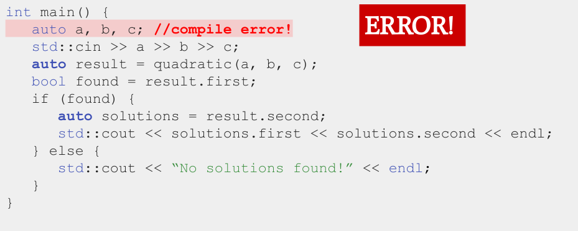
Can’t deduce the type b/c no value provided

Slide 25
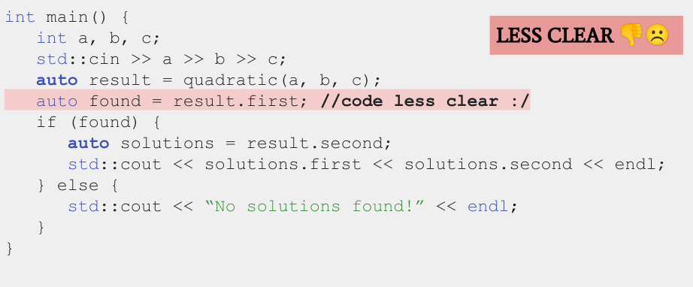
For simple types (like bool) type it out

Slide 26
Don’t overuse auto
...but use it to reduce long type names

Slide 27
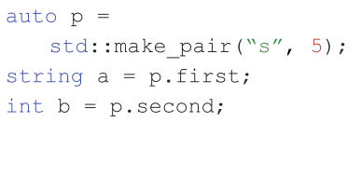
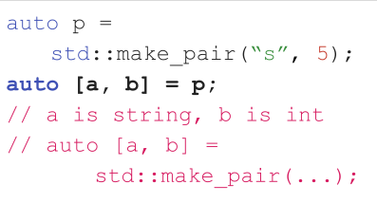
Structured Binding

Slide 28
Structured Binding
Structured binding lets you initialize directly from the contents of a struct
Before
After
📝 This works for regular structs, too. Also, no nested structured binding.

Slide 29
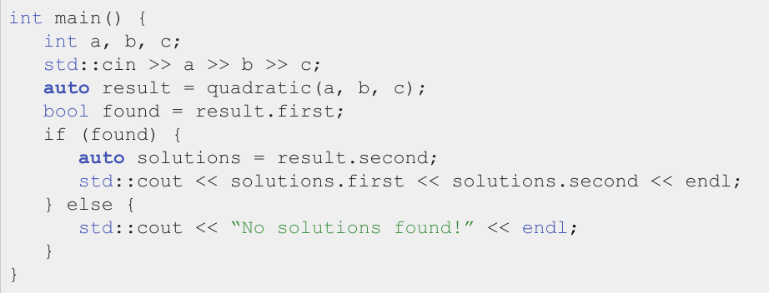
A better way to use quadratic…

Slide 30
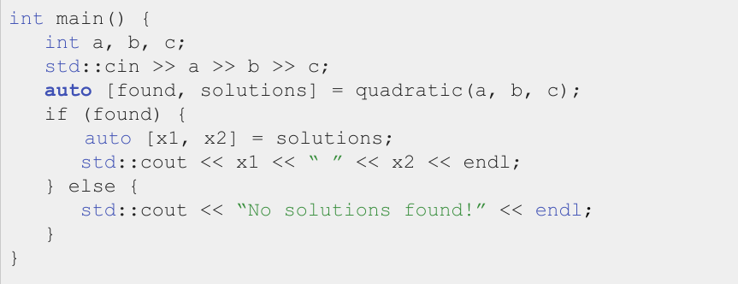
A better way to use quadratic…

Slide 31
Using Structured Binding
📝 This is better because it’s semantically clearer: variables have clear names.

Slide 32
Today
- Initialization
- Using auto
- References
- If time: Const

Slide 33
Definition
Reference: An alias (another name) for a named variable

Slide 34
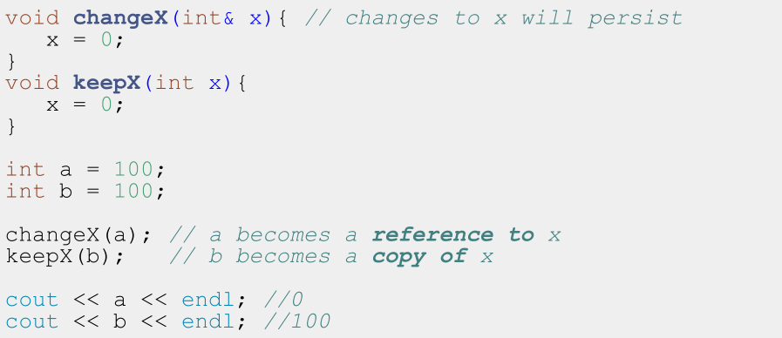

Slide 36
Standard C++ vector (intro)

Slide 37
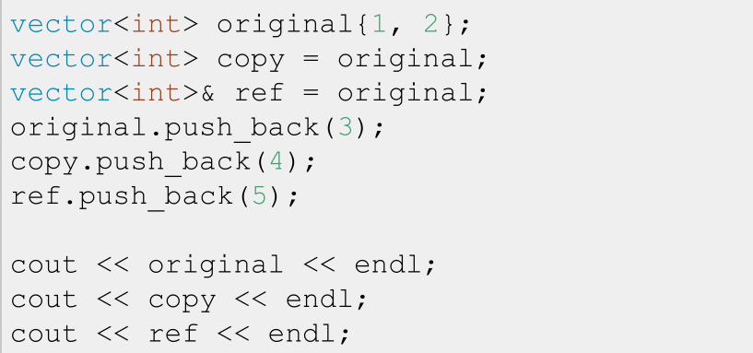
References to variables

Slide 38
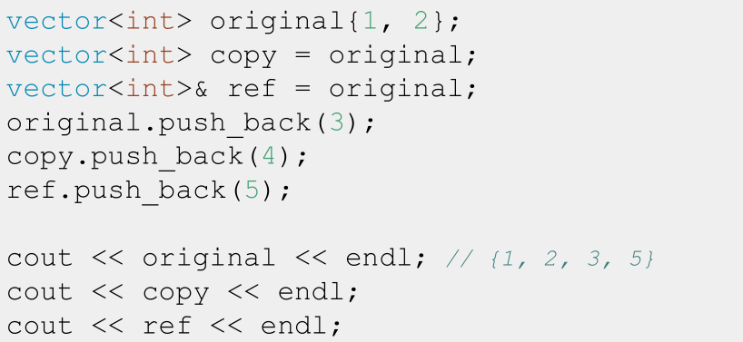
References to variables

Slide 39
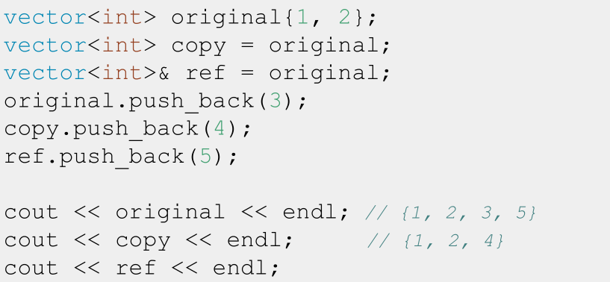
References to variables

Slide 40
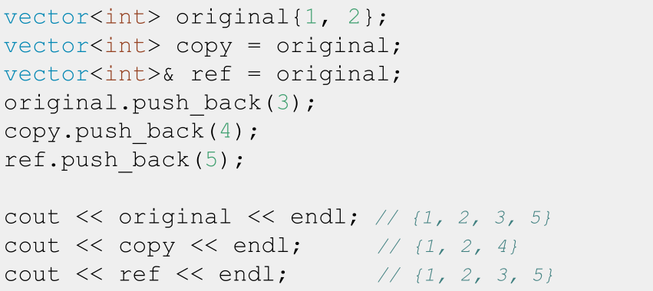
References to variables

Slide 41
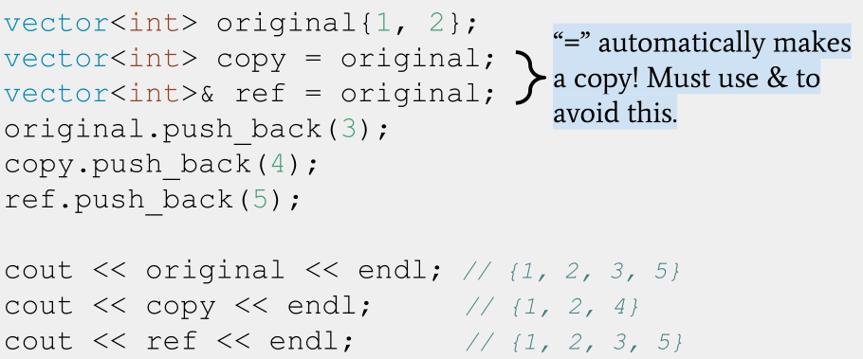
References to variables

Slide 42
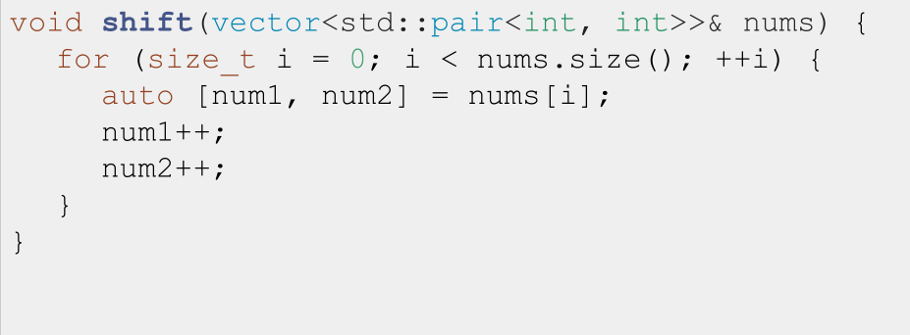
The classic reference-copy bug 1.0:

Slide 43
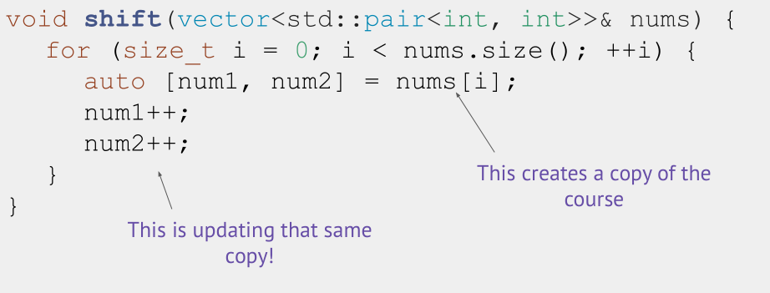
The classic reference-copy bug 1.0:

Slide 44
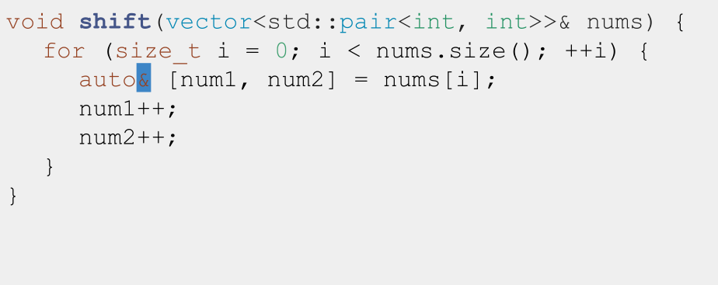
The classic reference-copy bug 1.0: Fixed

Slide 45
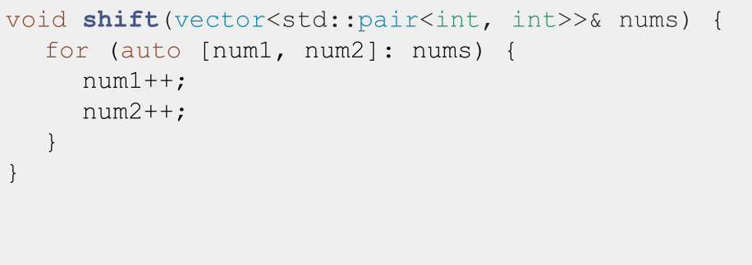
The classic reference-copy bug 2.0:

Slide 46
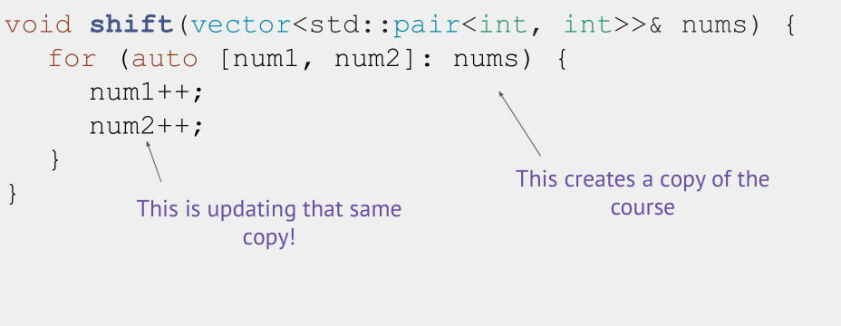
The classic reference-copy bug 2.0:

Slide 47
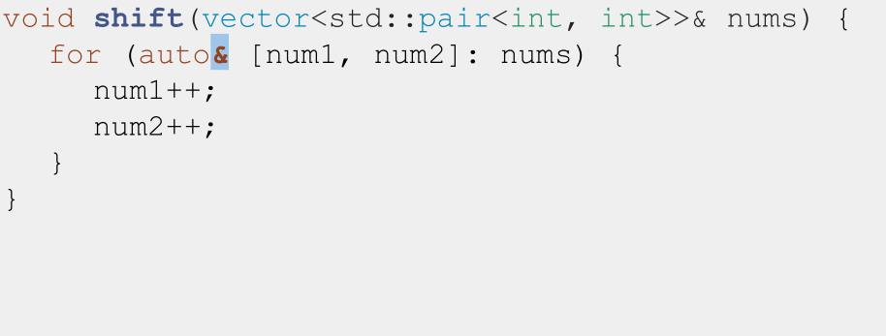
The classic reference-copy bug 2.0, fixed:

Slide 48
Definition: l-values vs r-values
- l-values can appear on the
left or right of an =
- x is an l-value
l-values have names
l-values are not temporary
- r-values can ONLY appear on the right of an =
- 3 is an r-value
r-values don’t have names
r-values are temporary
int x = 3;
int y = x;
int x = 3;
int y = x;

Slide 49
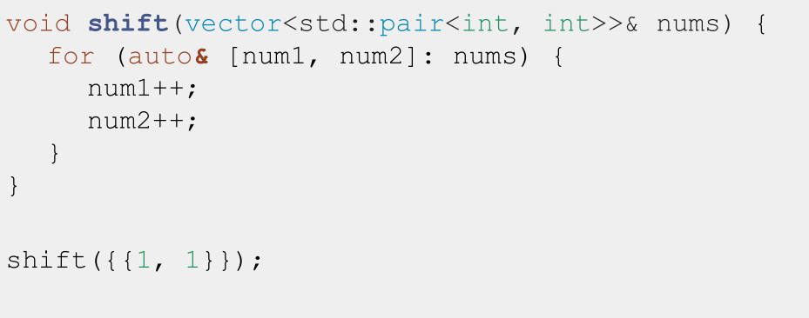
The classic reference-rvalue error

Slide 50
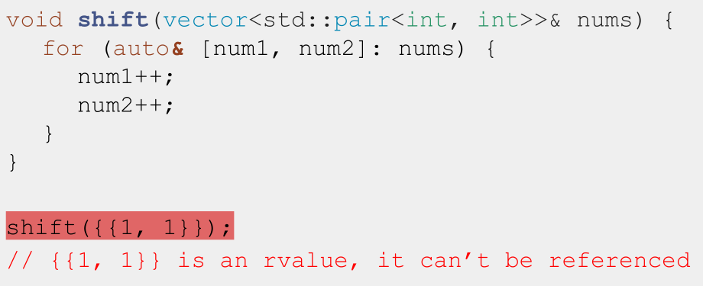
The classic reference-rvalue error

Slide 51
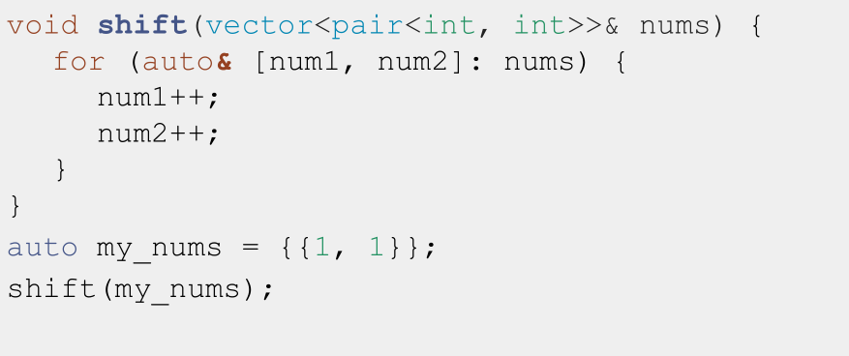
The classic reference-rvalue error, fixed

Slide 52
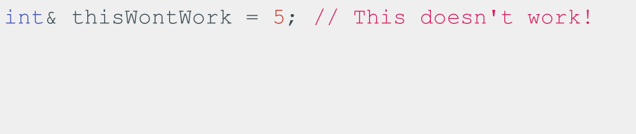
Note: You can only create references to variables

Slide 53
Note: You can only create references to variables

Slide 54
Today
- Initialization
- Using auto
- References
- If time: Const

Slide 55
BONUS: Const and Const References

Slide 56
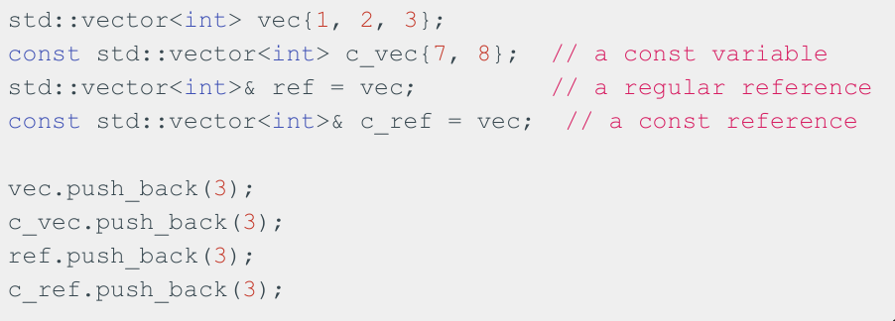
const indicates a variable can’t be modified!
const variables can be references or not!

Slide 57
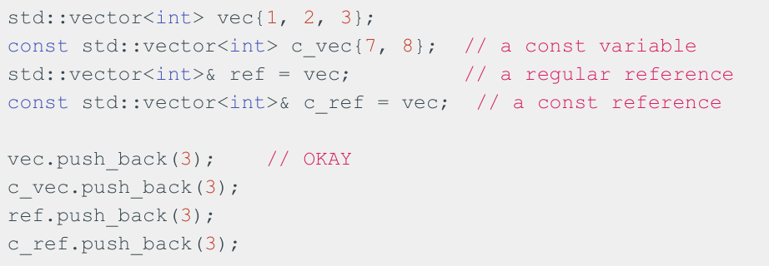
const indicates a variable can’t be modified!
const variables can be references or not!

Slide 58
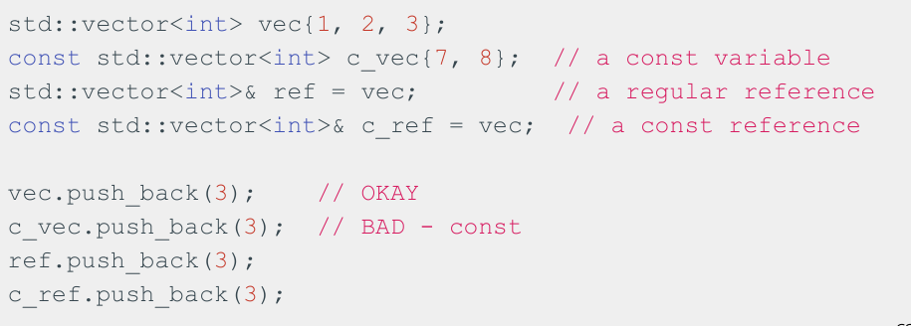
const indicates a variable can’t be modified!
const variables can be references or not!

Slide 59
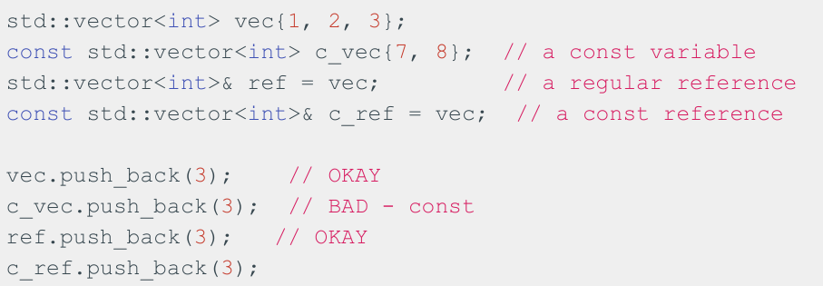
const indicates a variable can’t be modified!
const variables can be references or not!

Slide 60
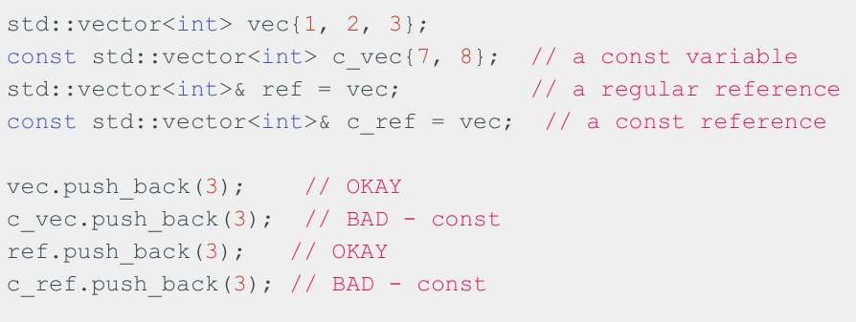
const indicates a variable can’t be modified!
const variables can be references or not!

Slide 61
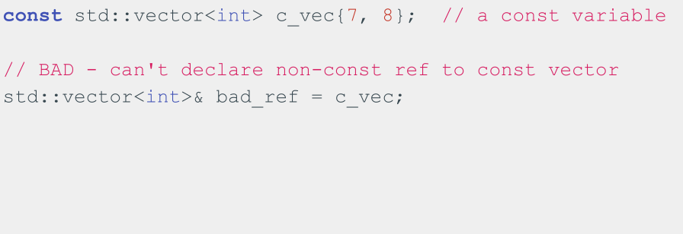
Can’t declare non-const reference to const variable!

Slide 62
Can’t declare non-const reference to const variable!

Slide 63
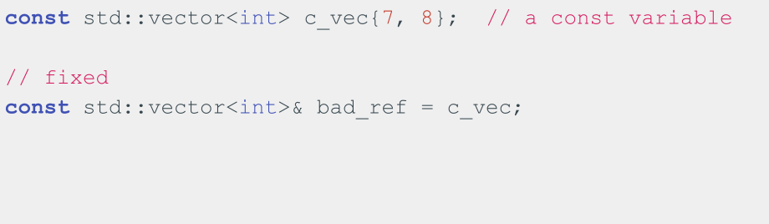
Can’t declare non-const reference to const variable!

Slide 64
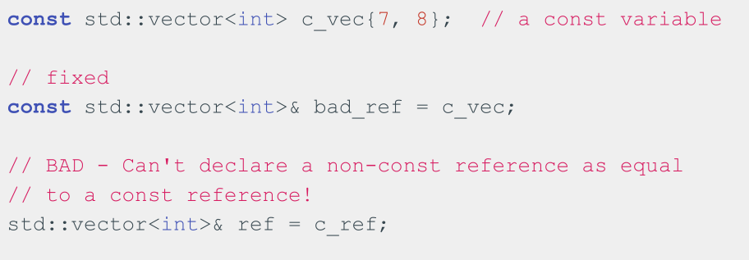
Can’t declare non-const reference to const variable!
c

Slide 65
Can’t declare non-const reference to const variable!
c

Slide 66
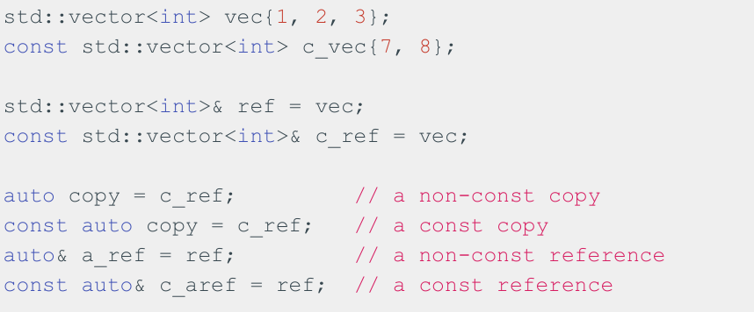
const & subtleties

Slide 67
const & subtleties

Slide 68
Remember: C++, by default, makes copies when we do variable assignment! We need to use & if we need references instead.

Slide 69
When do we use references/const references?
- If we’re working with a variable that takes up little space in memory (e.g. int, double), we don’t need to use a reference and can just copy the variable
- If we need to alias the variable to modify it, we can use references
- If we don’t need to modify the variable, but it’s a big variable (e.g. std::vector), we can use const references

Slide 70
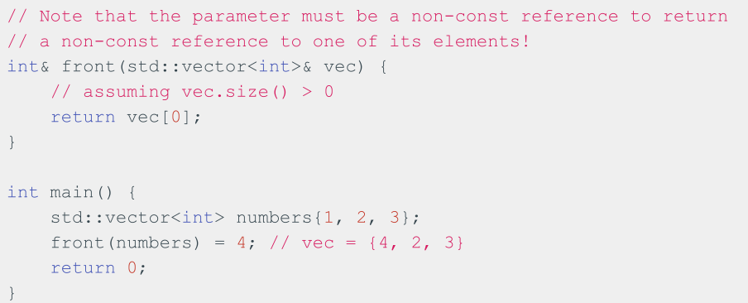
You can return references as well!

Slide 71
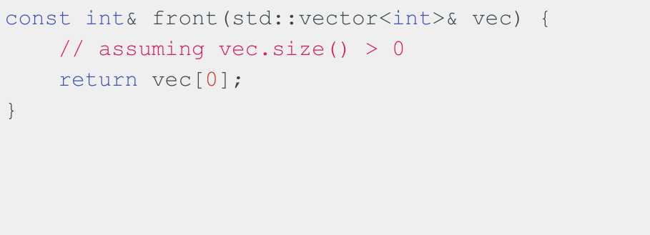
Can also return const references

Slide 72
Recap
- Uniform Initialization
- A “uniform” way to initialize variables of different types!
- References
- Allow us to alias variables
- Const
- Allow us to specify that a variable can’t be modified

Slide 73
Coding for love, Coding for the world
Qijun Zhao
qjzhao@scu.edu.cn

